Slide 1
Radio Consulting
Based On Spotify Trends
1:23
2:36

Slide 2

About Us
We are a consulting agency that provides meaningful insights to radio stations/producers.
We are a team of two with background in Mathematics:
Avramidis Theofilos
Korolis Alexandros

Slide 3
The Basis
Popularity
Song Duration
Top Genres
Discover
Song Plays by release date
How duration changed through the Years
By decade

Slide 4
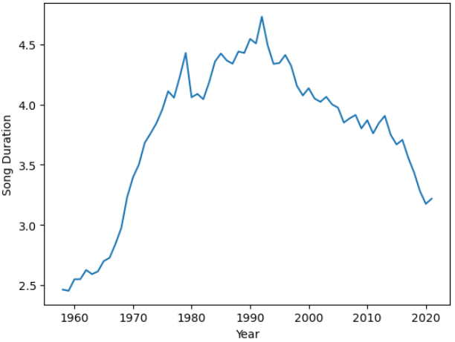
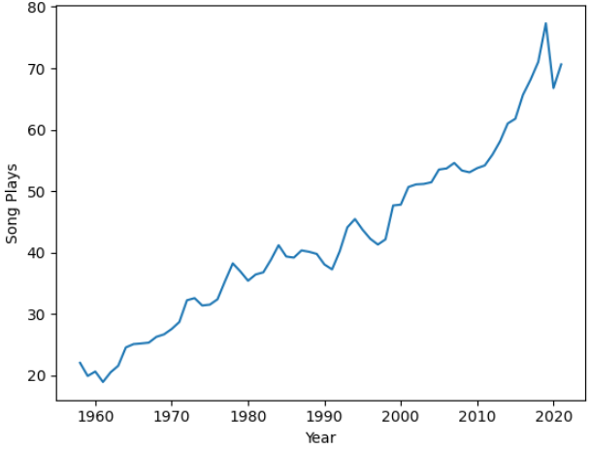
Song Duration
Now listen
Duration Increases by year
Max Duration in the 90s
Decreases after that
Nowadays songs tend to be shorter.
Popularity
New Songs tend to be more popular.

Slide 5
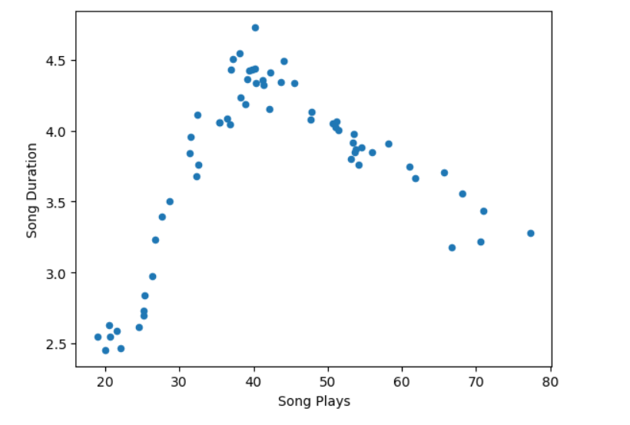
Duration VS Popularity
Now listen
Strong correlation between Duration and Popularity.
More popular songs have shorter durations .
Songs in the middle of the graph represent more like the 80s/90s era.

Slide 6
Now listen
What makes a radio program great?
Does hip hop music fit in a 60s radio
program?
Is Metallica a famous choice for a 90s theme?
Let us examine :
Decade thematicals(60s,70s..)
Top Genres
Top Performers

Slide 7
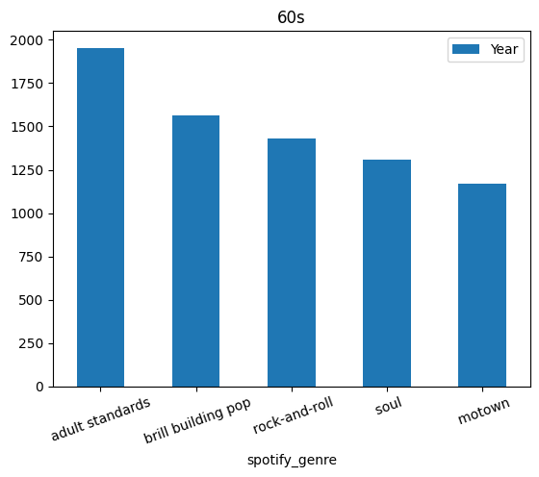
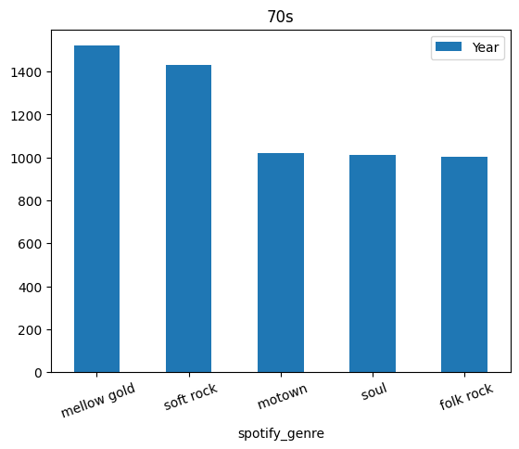
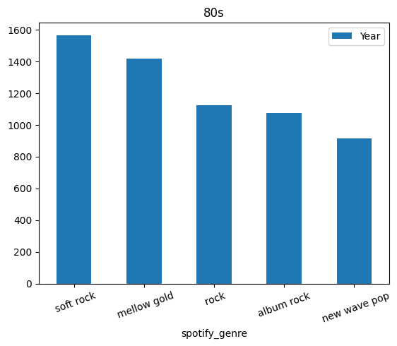
Now Playing
Decade Thematicals
Top Performers
The Beatles
Beach Boys
Sam Cooke
Elton John
Bee Gees
Carpenters
Madonna
Billy Joel
Journey

Slide 8
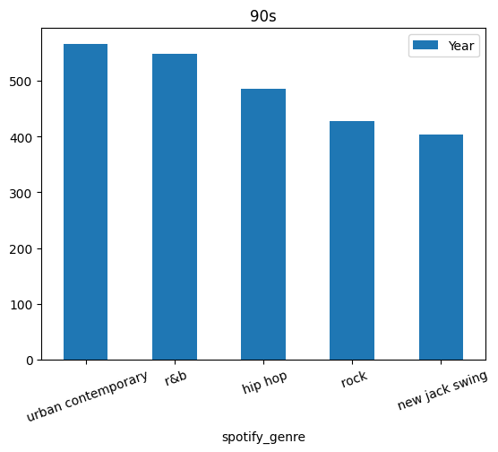
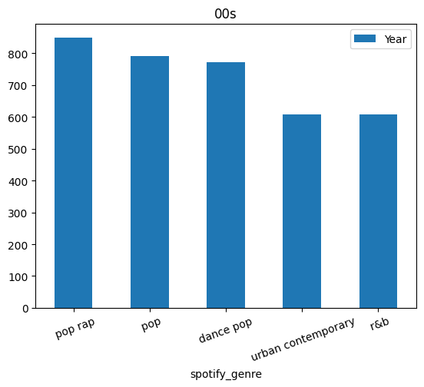
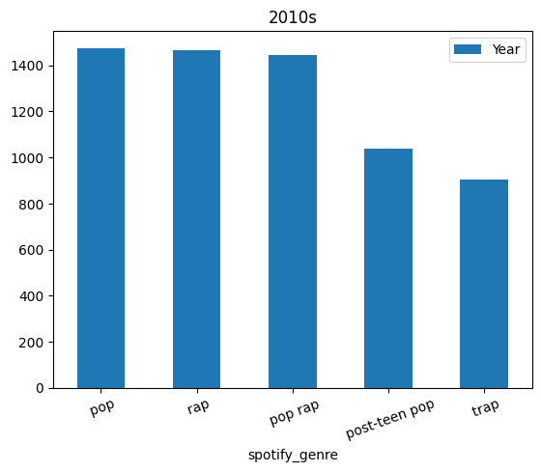
Now Playing
Decade Thematicals
Top Performers
Madonna
Mariah Carey
Celine Dion
Rascal Flatts
Toby Keith
Glee Cast
Glee Cast
Drake
Taylor Swift

Slide 9

Now Playing
Genre Thematicals
Another aspect of building up your radio show is based on Genre. Many people listen to a specific type of music hence genre based radio shows are a good alternative.
For this purpose it seems appropriate to pick up top performers of each genre.
ex.Top5 performers for some genres
Rock : The Rolling Stones, U2, Bon Jovi, Aerosmith, Billy Joel
Mellow Gold : Elton John, Neil Diamond, Chicago, Fleetwood Mac, Bruce Springsteen
Metal : Van Halen, Kiss, Alice Cooper, Metallica, Rush
Hip Hop : Drake, Eminem, Lil Wayne, J. Cole, Future

Slide 10

Conclusion
Recent and shorter in duration songs tend to be more popular
Choose from top performers based on popularity
Select decade theme related to the genre
Pick top performers for each genre

